Slide 1

CTRAN: StopSpot Project
Brian Allen, Marcus Kwong

Slide 2
Project Goals
Provide the user with static transit stop locations throughout the C-Tran service map and dynamic vehicle location data to better improve accuracy of static GPS positioning data of C-Tran transit stops.
Analyze static bus stop location GPS data based on dynamic bus event data through March 2019 – April 2019.
Create a web application providing visualization tools for bus stop analysis.

Slide 3
Data Provided
Stop Locations from the January – April service period.
Stop events from March 01, 2019 – April 30, 2019.

Slide 4
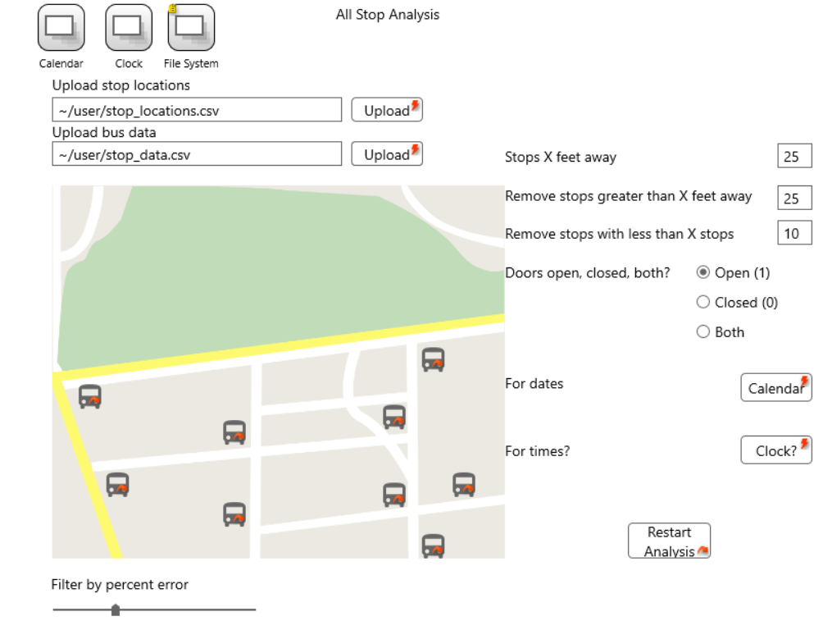
Mock Up Design: System View

Slide 5
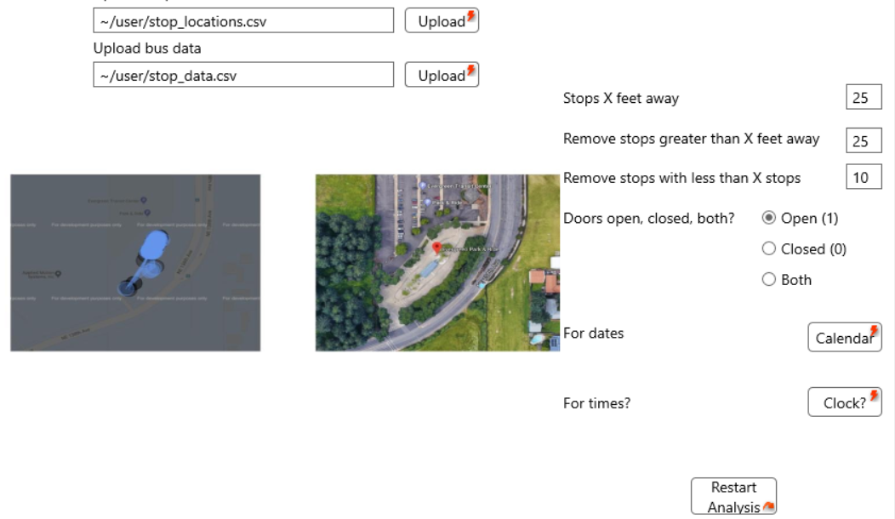
Mock Up Design: Single Stop

Slide 6


Implementation
Django-based web application
Postgresql database
Notes:
Django provides a lot of functionality and a easy-to-use web application framework which works well with a postgresql database, which is where we are holding the data.
Django is useful because it is an open-source python framework which claims to take care of a lot of the hassle in web development and allows users to focus more on developing the components for the application.

Slide 7
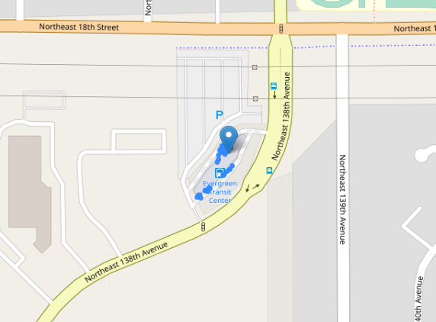
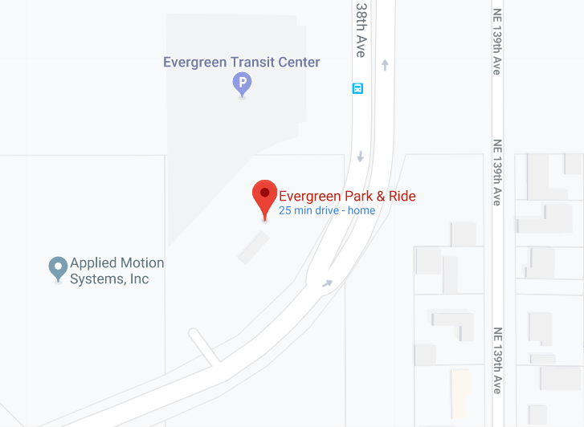
Stop #102

Slide 8
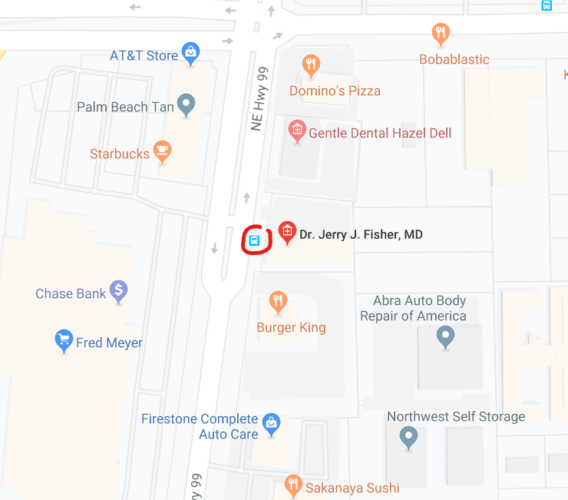
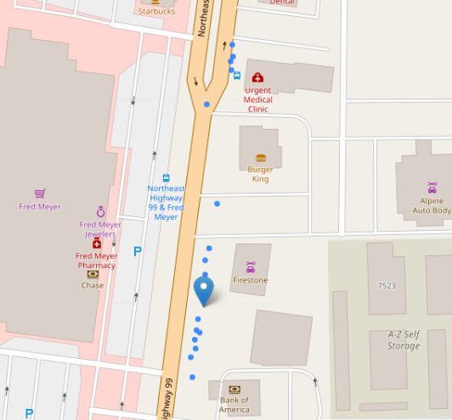
Stop #1348

Slide 9
Looking Ahead
More filtering tools
Stop search capabilities
Persistence
UI features

